Slide 1

JIRA AGILE
Function share
https://test1trip.atlassian.net

Slide 2

DIRECTORY
01
JIRA Agile Basics
02
JIRA Agile For Scrum
03
JIRA Agile For Kanban
04
JIRA Agile Advanced

Slide 3
01
JIRA Agile Basics
Get Jira Agile
Support Agile Methodology
Basic Elements & Classification

Slide 4

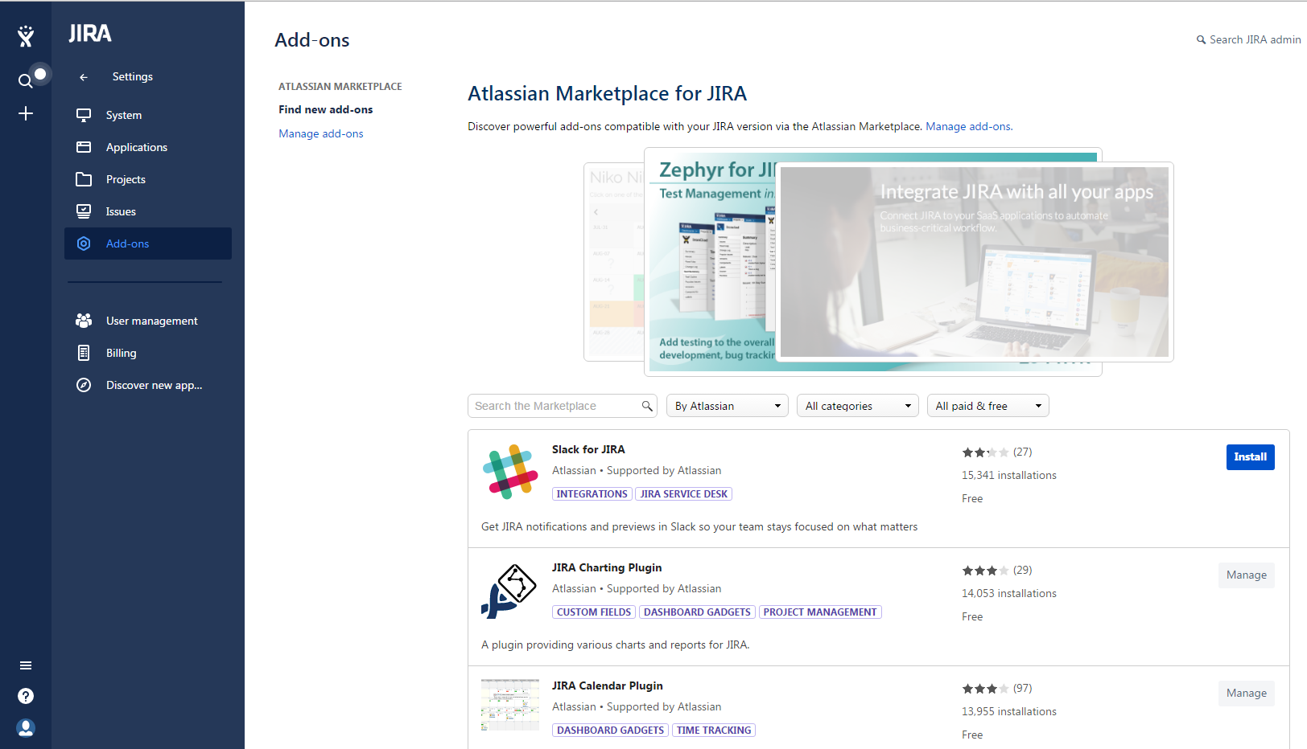
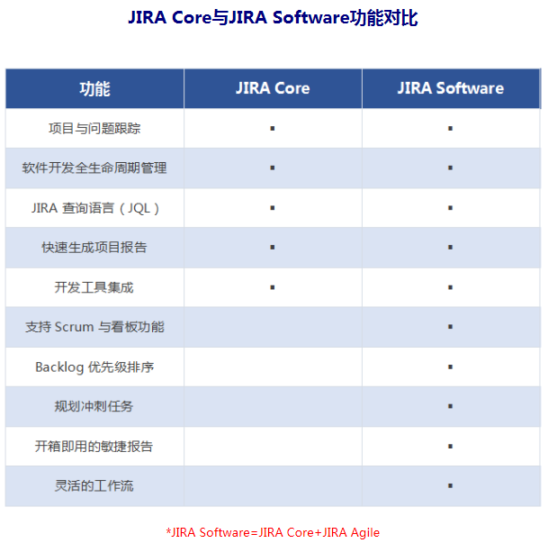
Get Jira Agile
JIRA Core
JIRA Add-ons
JIRA Software
1

Slide 5
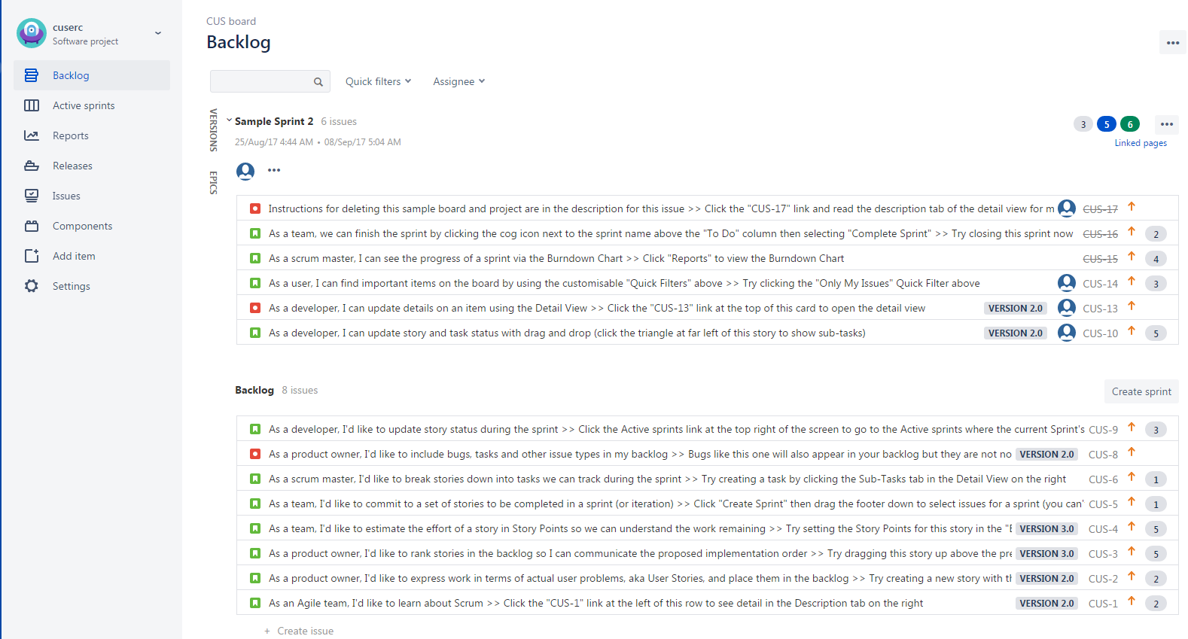
Support Agile Methodology
Scrum
Development Team
Backlog
Sprint
Iterate
2

Slide 6
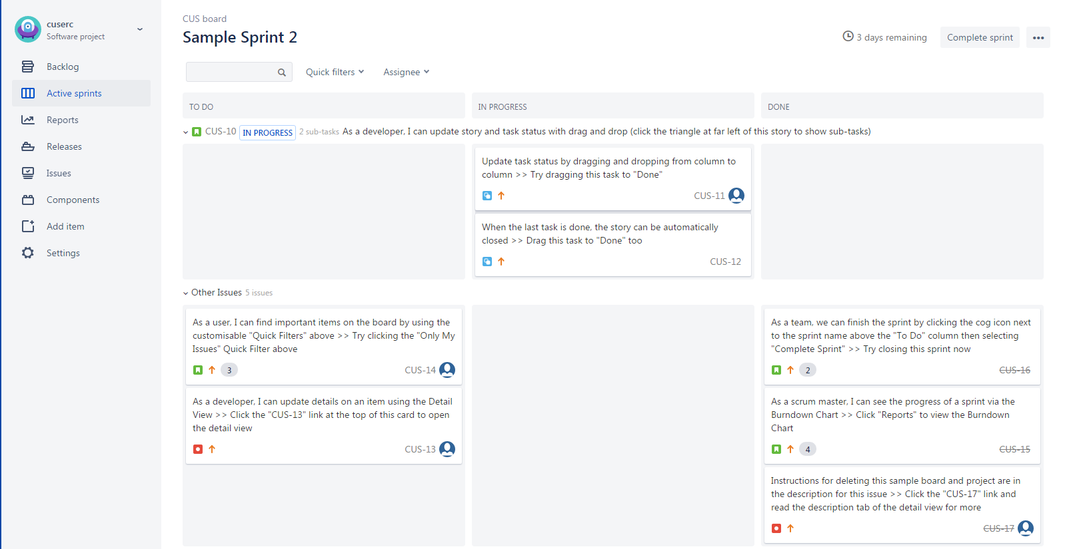
Support Agile Methodology
Scrum
Development Team
Backlog
Sprint
Iterate
3

Slide 7
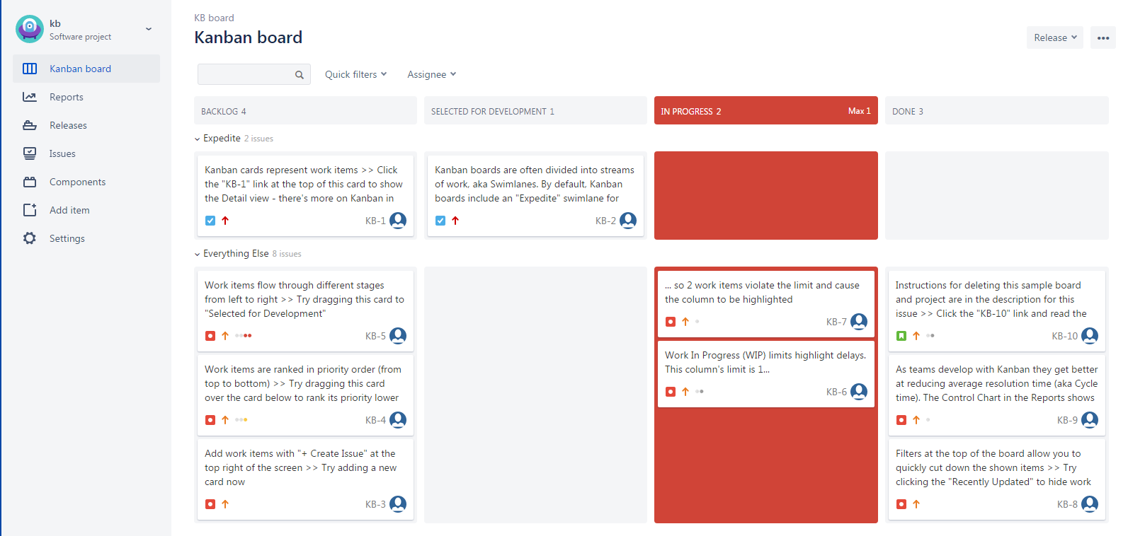
Support Agile Methodology
Kanban
Operation Team
Just-in-time
Visualizing Workflow
Task
Progress
4

Slide 8
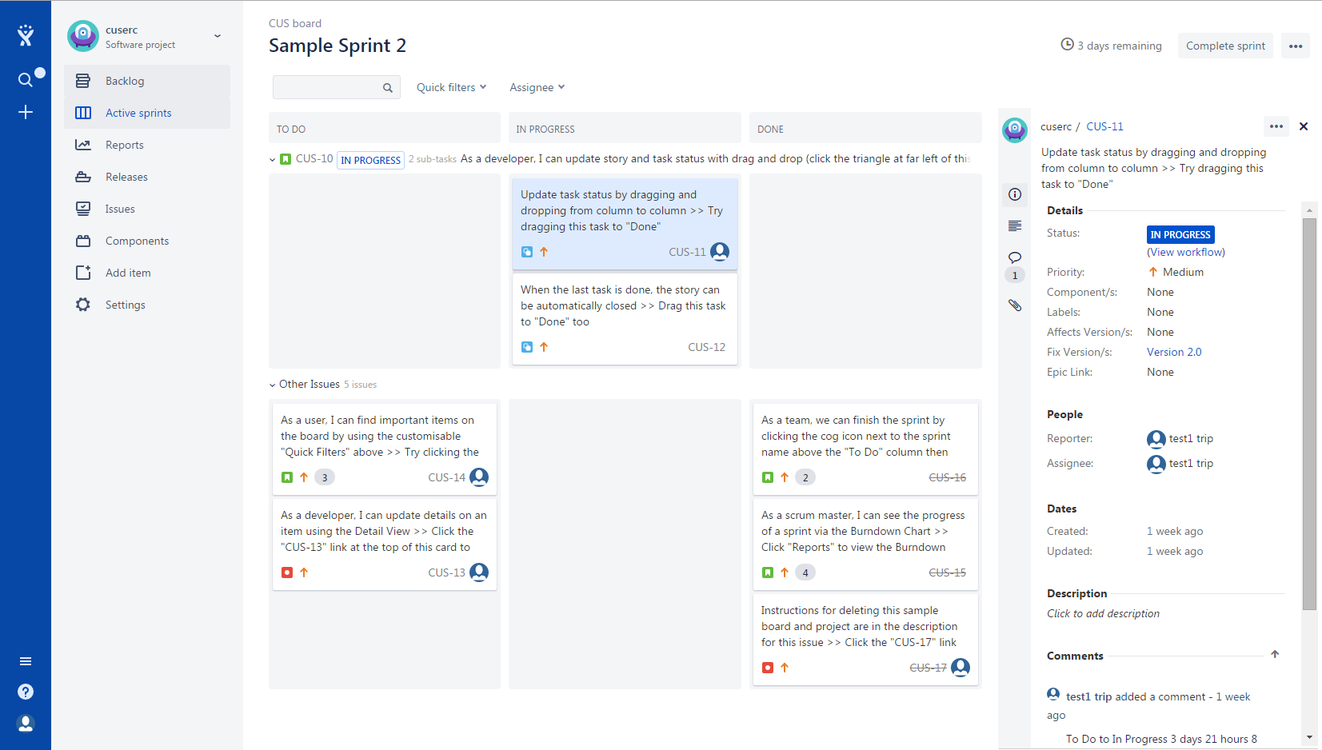
Basic Elements & Classification
Agile Board
New!
Main!
Visualizing Backlog
Track
Change!
Progress!
5

Slide 9
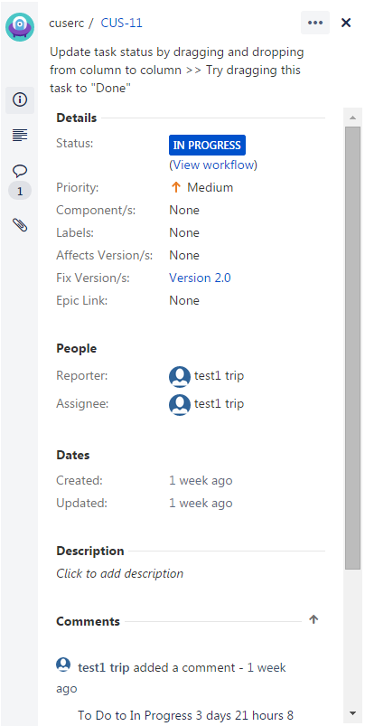
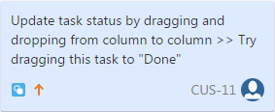
Basic Elements & Classification
Card
Post-it Note
User Story
Issue
6

Slide 10
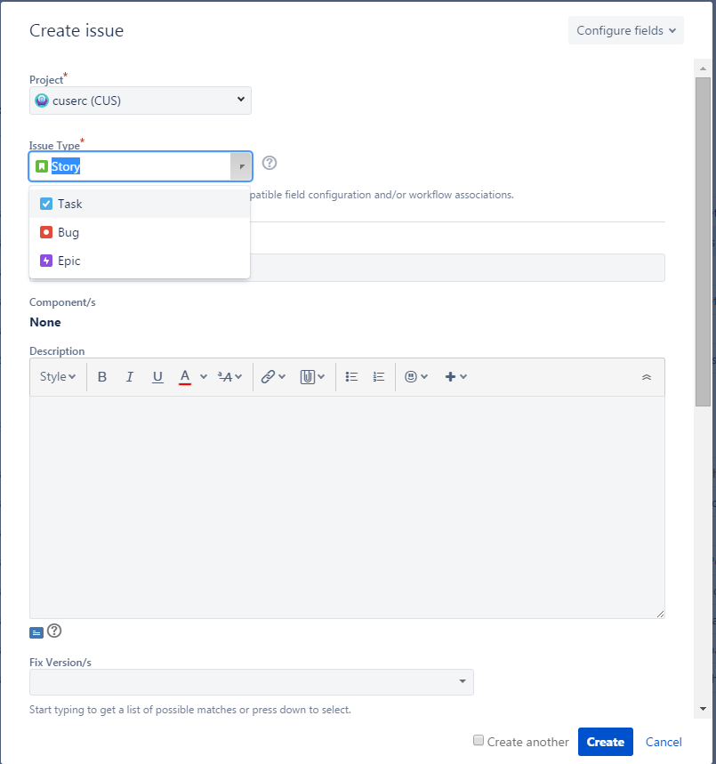
Basic Elements & Classification
Issues & Types
Epic
Big User Story\Theme
Story
Single Feature/End User
Task
Technical Work/Implement Story
Bug
Problem/Product Functions
7

Slide 11
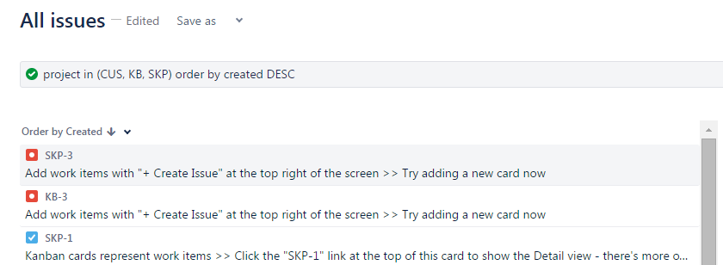
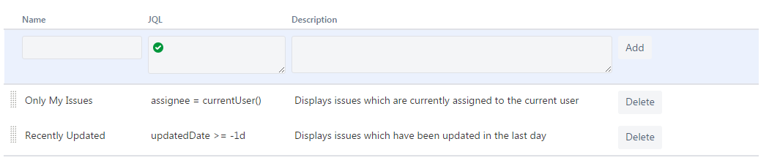
Basic Elements & Classification
Filters & JQL
Multiple Projects
Limit
Issues
8

Slide 12
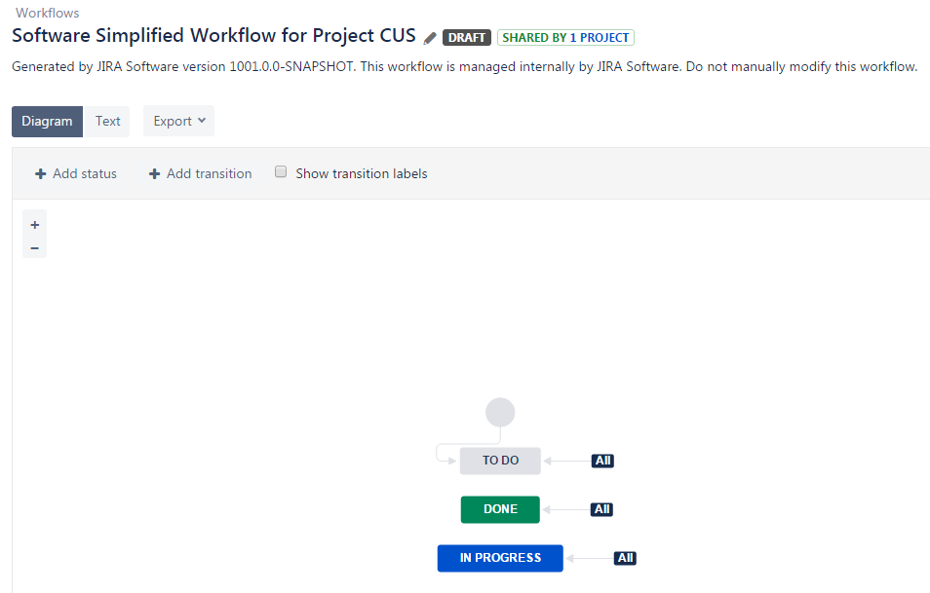
Basic Elements & Classification
Workflows
Core
Adapt
9

Slide 13
02
JIRA Agile For Scrum
Scrum Board
Sprint & Report
Customizing

Slide 14
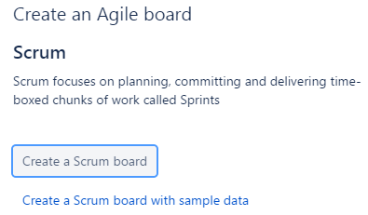
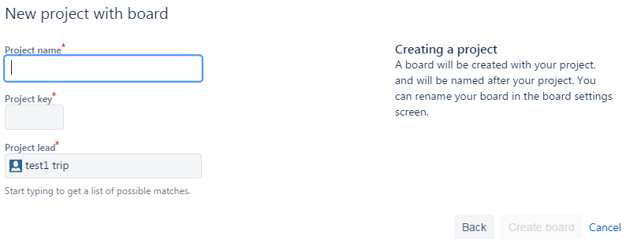
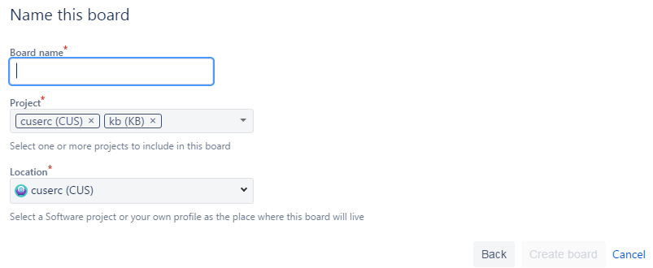
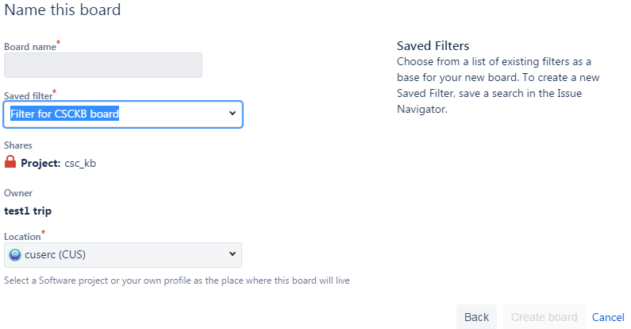
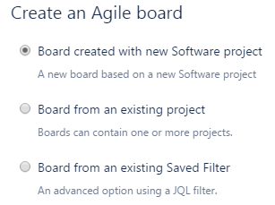
Scrum Board
Interface: Team Participate\Improve Collaboration\Iteration
Create
Three
Modes
Issues
Versions
10

Slide 15
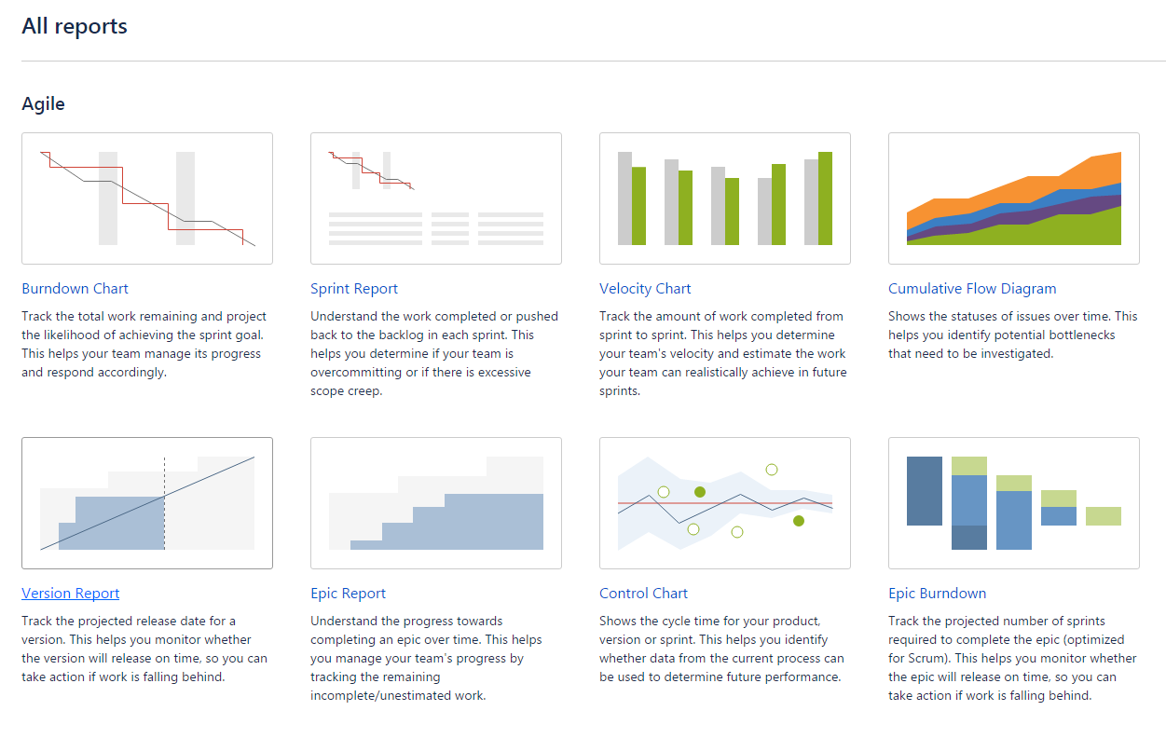
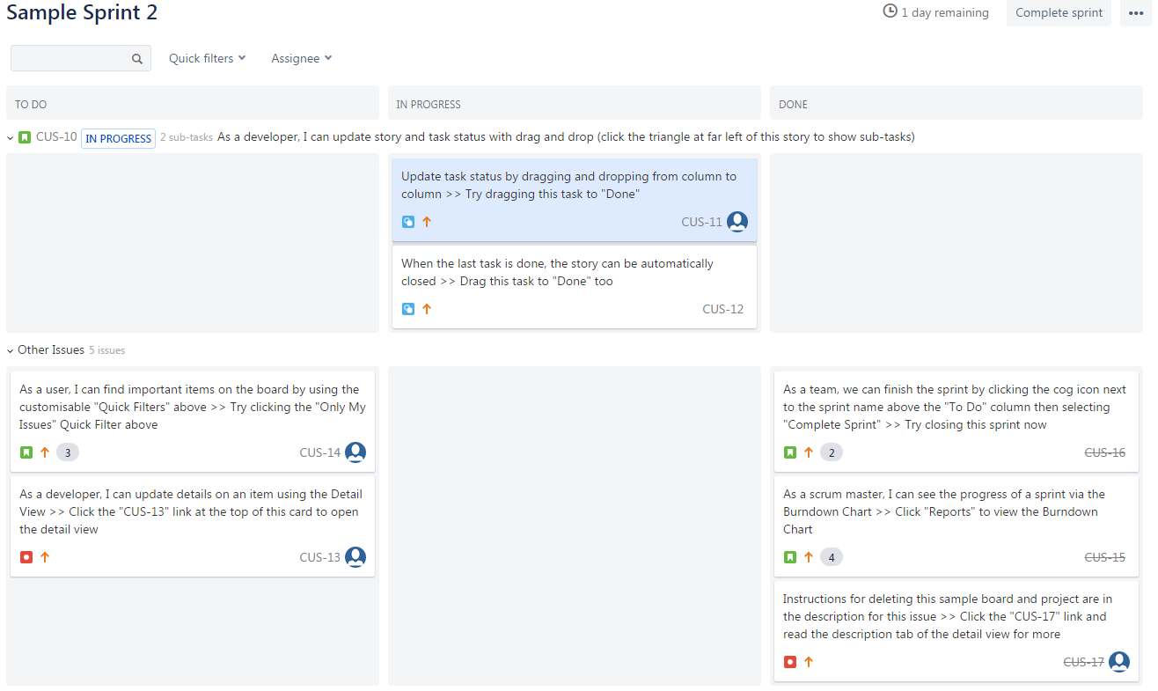
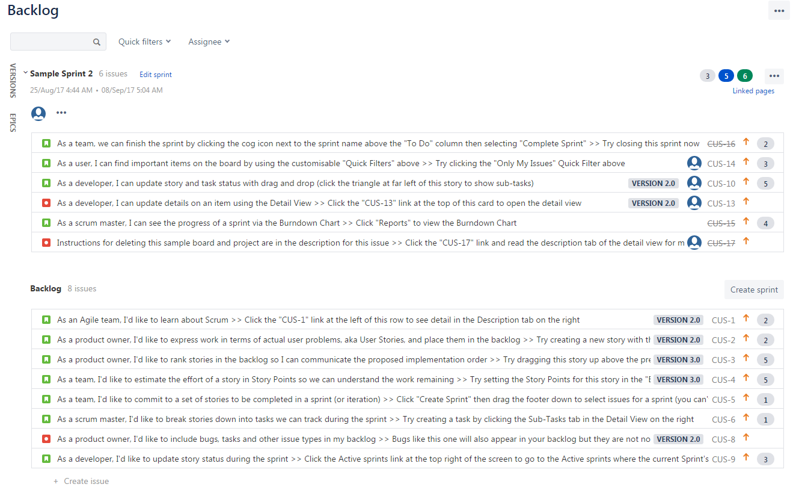
Scrum Board
Interface: Team Participate\Improve Collaboration\Iteration
Create
Three
Modes
Issues
Versions
11

Slide 16
Scrum Board
Interface: Team Participate\Improve Collaboration\Iteration
Create
Epic
Big User Stories\Group Similar User Stories Together
Three
Modes
Story
Independent\Negotiable\Valuable\Estimable\Small\Testable
Issues
Versions
Task
12

Slide 17
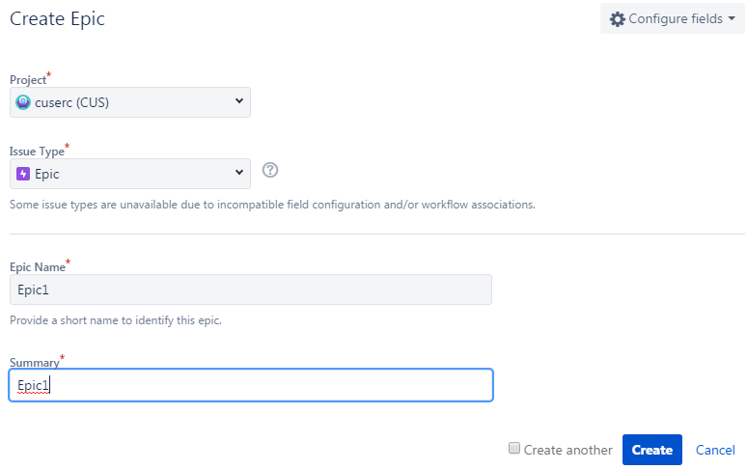
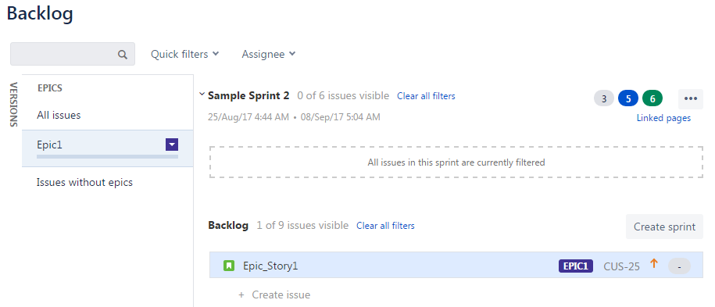
Scrum Board
Interface: Team Participate\Improve Collaboration\Iteration
Epic
Create
Three
Modes
Issues
Versions
13

Slide 18
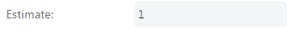
Scrum Board
Interface: Team Participate\Improve Collaboration\Iteration
Story - Estimate
Create
Important
Velocity
How much work your team can deliver in a sprint
Three
Modes
Story points
Measure the complexity or level of effort required to complete a story
Issues
Goal
Continuously Improve
Accurately predicting team's velocity
Become easier to manage the workload for each sprint
Versions
14

Slide 19
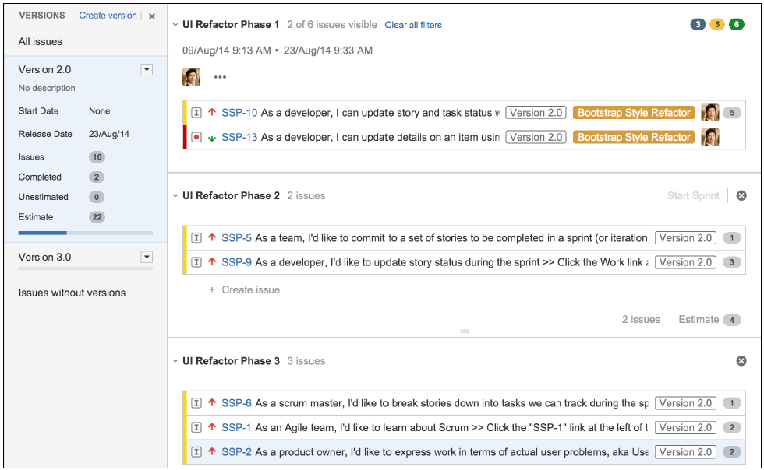
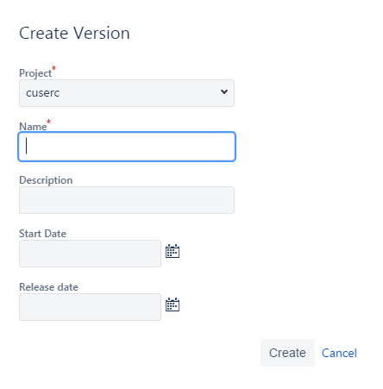
Scrum Board
Interface: Team Participate\Improve Collaboration\Iteration
Version can span across many sprints
Create
Three
Modes
Issues
Versions
15

Slide 20

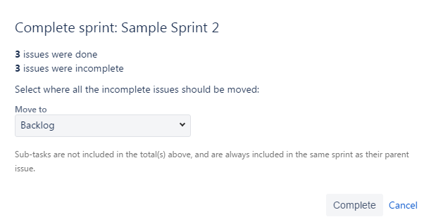
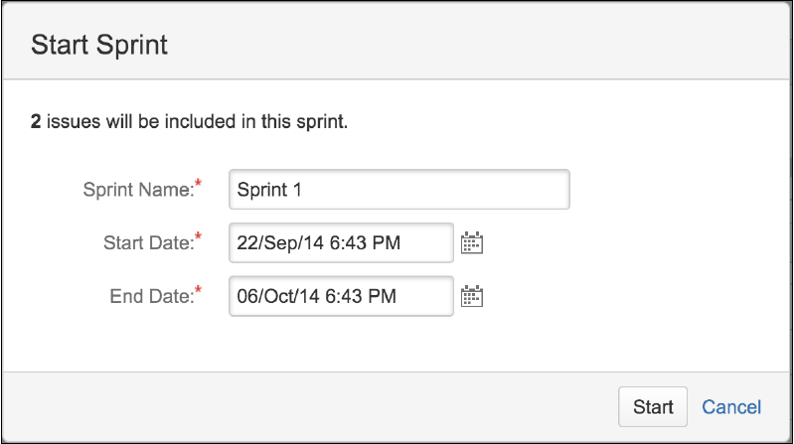
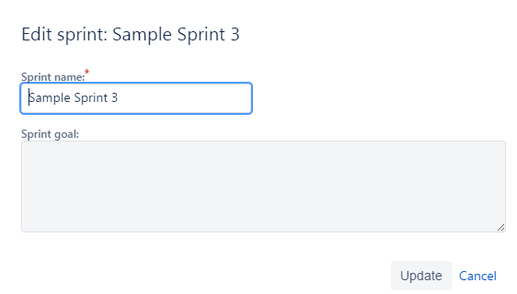
Sprint & Report
Decides what we should focus and work on
only have one active sprint per board at any time
any unfinished issues will be automatically moved back to the top of the backlog
Sprint
Report
16

Slide 21
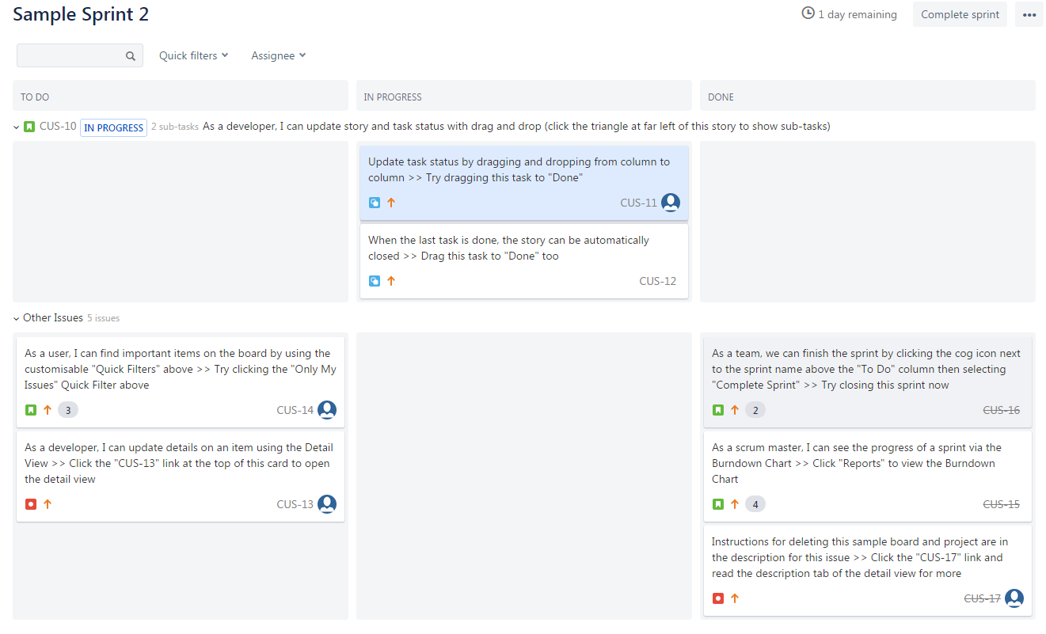
Sprint & Report
Columns: Jira workflow statuses
Swimlanes: Group similar issues together Example: assignee, story, or epic.
Sprint
Report
17

Slide 22
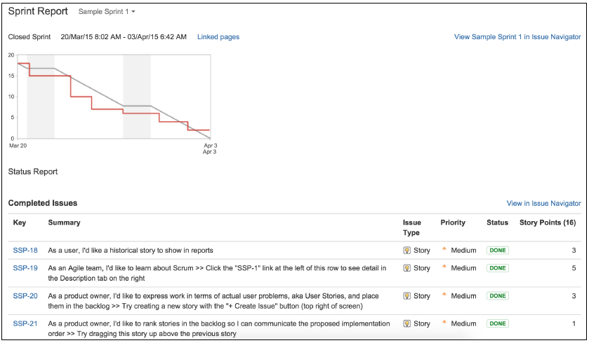
Sprint & Report
Track a sprint's progress
The sprint report
Quick Snapshot\Burndown Chart\Summary Table
Sprint
Report
18

Slide 23
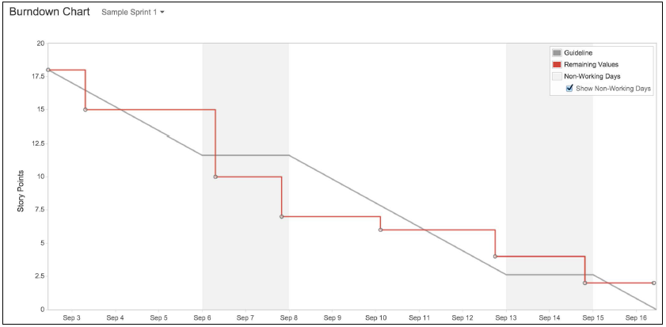
Sprint & Report
Track a sprint's progress
The burndown chart
Compare: Estimates & Actual
Sprint
Report
19

Slide 24
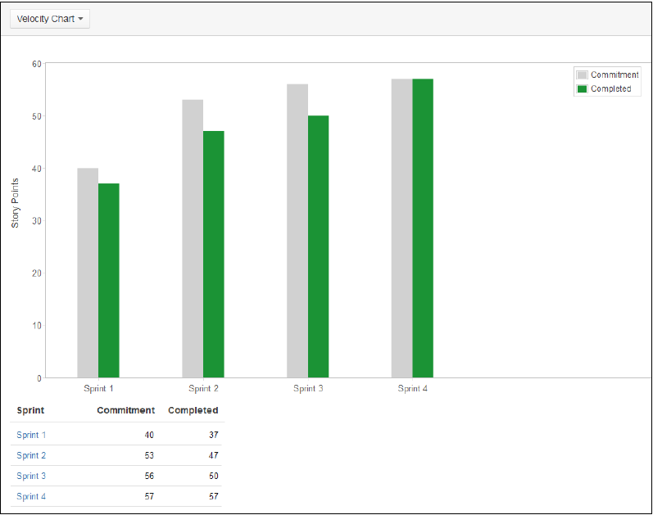
Sprint & Report
Track a sprint's progress
The velocity chart
Avoid the volatility of commitment delivery
Sprint
Compare: Estimates & Actual
Past Sprints
Report
Average Completed
≈True Velocity
20

Slide 25

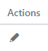
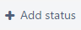
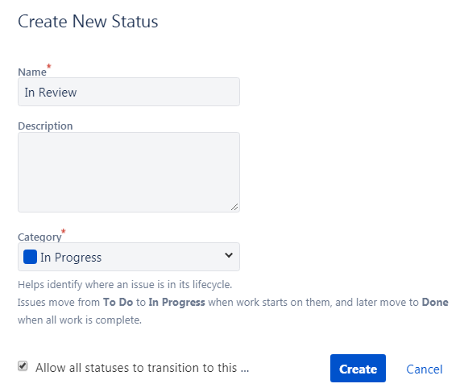
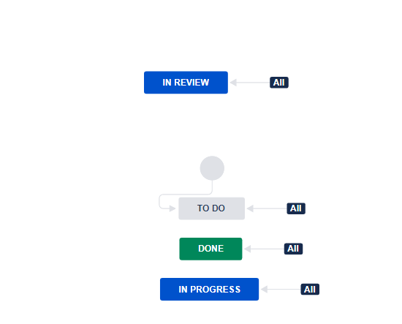
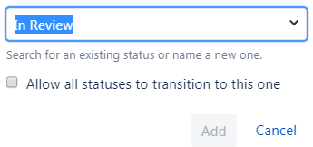
Customizing
New Columns
Project X
Workflow
Columns
Swimlanes
21

Slide 26

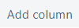
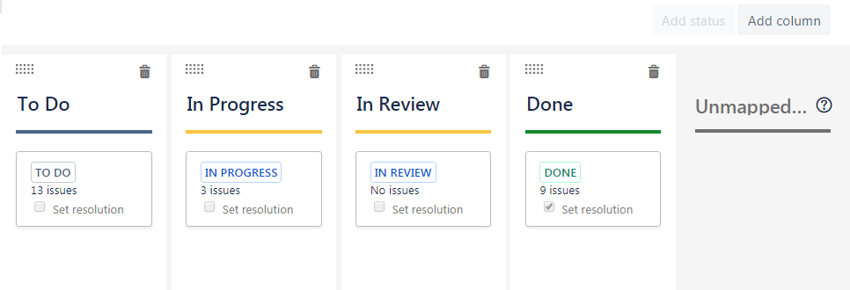
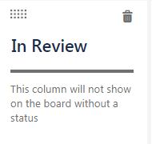
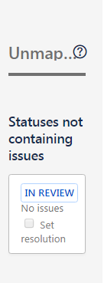
Customizing
New Columns
Project X
Columns
Swimlanes
22

Slide 27
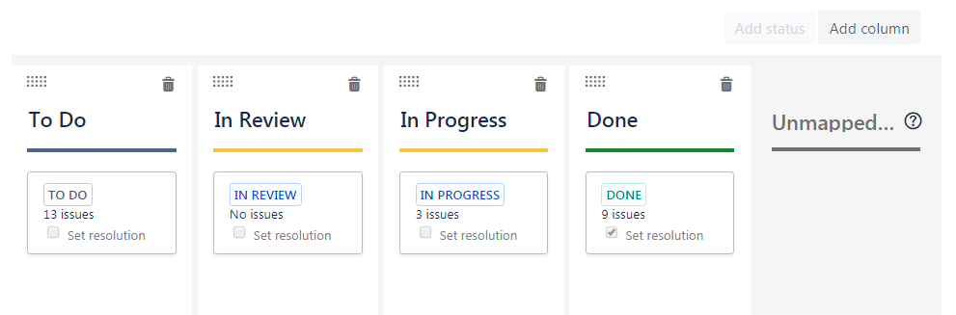
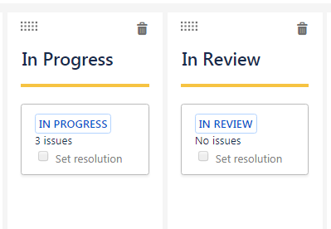
Customizing
Column Layout
Columns
Swimlanes
23

Slide 28
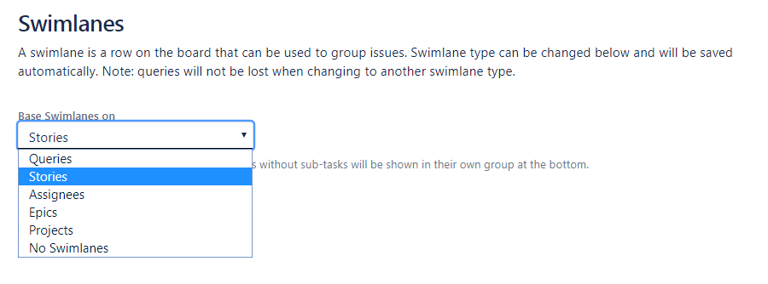
Customizing
Setting Swimlanes
Stories\Assignees\Epics\Projects\No Swimlanes
Columns
For example, with the Assignees option, you can easily get each team member's workload by just
looking at the board.
Swimlanes
24

Slide 29
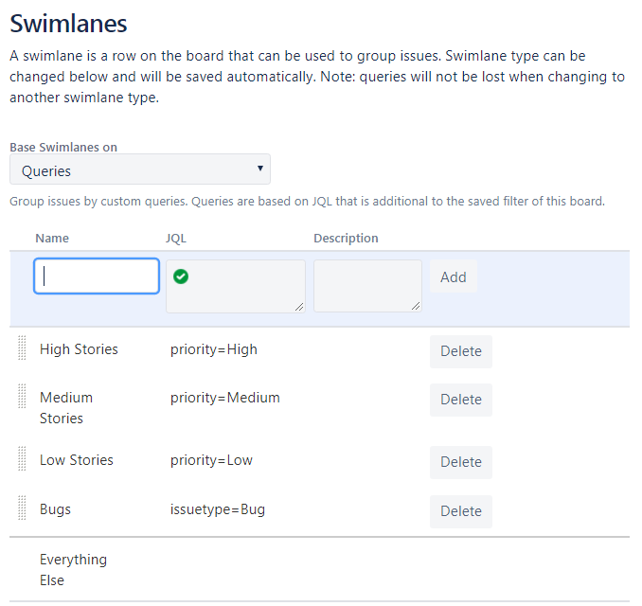
Customizing
JQL & Quick Filters
Project X
Queries
Columns
Note that the order of swimlanes is important.
The order will determine both the
placement of each swimlane and the
swimlane an issue will belong to.
Swimlanes
25

Slide 30
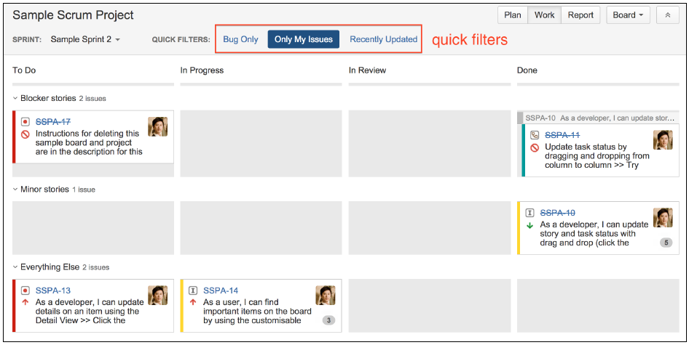
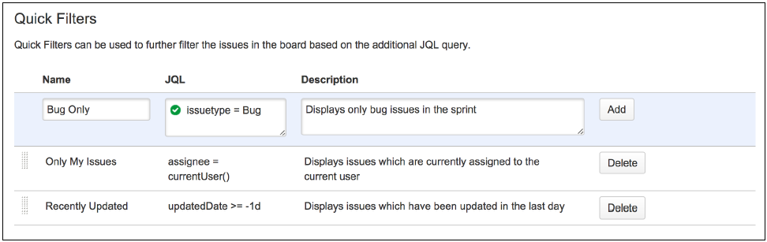
Customizing
JQL & Quick Filters
Project X
Columns
Let you focus on the issues to care about
Swimlanes
26

Slide 31
03
JIRA Agile For Kanban
Kanban
Report
Difference Scrum & Kanban

Slide 32
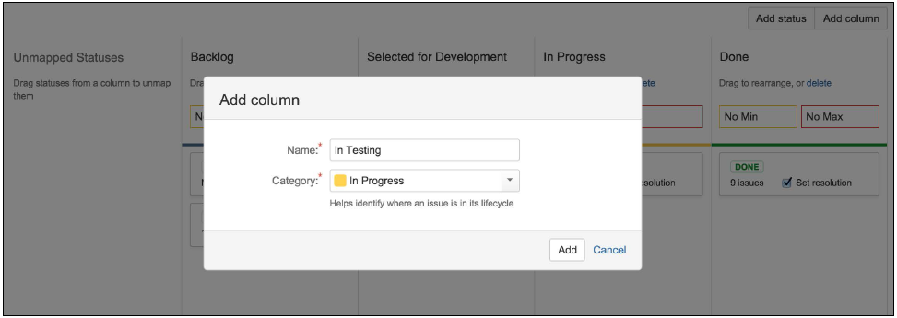
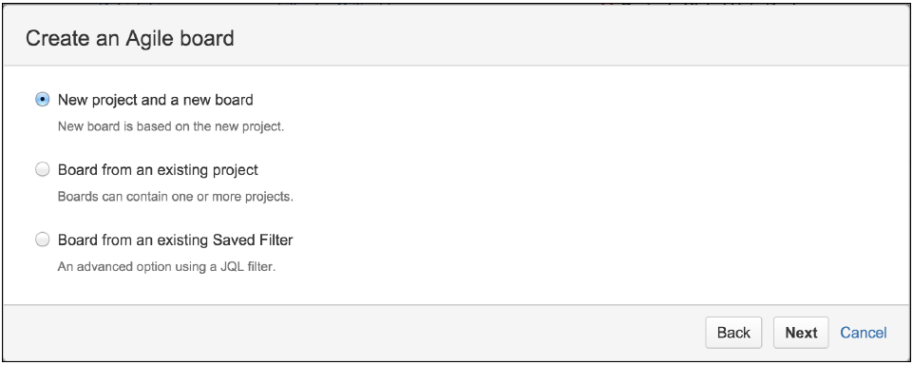
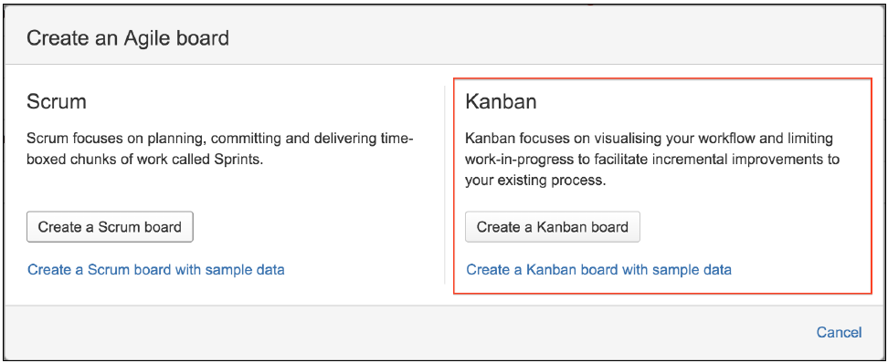
Kanban
Create
Customizing
column constraints
27

Slide 33


Kanban
Column Constraint
Create
Customizing
Column Constraints
28

Slide 34
Kanban
Question:"What is the correct limit I should set for each of my workflow statuses?"
Create
Limit set too high: You will have idle tasks sitting around, and this leads to bad lead/cycle time.
Limit set too low: You will have idle people waiting for work, and this leads to bad productivity.
Customizing
Answer: Try & Experiment
Column Constraints
29

Slide 35

Report
Be able to visually identify if there are any bottlenecks in a particular status in your team's workflow.
Cumulative Flow Diagram
Control Chart
30

Slide 36

Report
The control chart shows you the average lead time of your team over a period of time.
Cumulative Flow Diagram
Control Chart
31

Slide 37
Difference Scrum & Kanban
Scum
Kanban
VS
Backlog
No Backlog
Sprint
No Sprint
Sprint Constraints
Column Constraints
Limits the amount of work per iteration
limits the amount of work per workflow status
Suitable for development teams
Suitable for operation teams
32

Slide 38
04
JIRA Agile Advanced
Customizing Agile Cards
Parallel Sprints
Integrating Jira Agile With Confluence

Slide 39

Customizing Agile Cards
Project X
Issue Types\Priorities\Assignees\Queries
Card color
Card layout
Card details
33

Slide 40


Customizing Agile Cards
Project X
Queries: duedate <= "1d"
Card color
Card layout
Card details
34

Slide 41

Customizing Agile Cards
Project X
Card color
Lets you add
a maximum of three fields
not to add fields
such as description
Card layout
Backlog & Active sprints
lets you set
two different sets of fields
Card details
35

Slide 42


Customizing Agile Cards
Project X
Card color
Card layout
Card details
36

Slide 43




Parallel Sprints
JIRA
The Features:
multiple teams working on the same project, and sharing the same backlog,
you will need to be able to have multiple sprints running in parallel.
But:
The features that are in the beta testing phase.
They are not supported and are subject to future changes, so use them with care.
37

Slide 44

Integrating Jira Agile With Confluence
A Complete Agile Experience
Setting
JIRA
From Epics
From Confluence
Sprint Meeting Notes
38

Slide 45





Integrating Jira Agile With Confluence
A Complete Agile Experience
Setting
From Epics
From Confluence
Sprint Meeting Notes
39

Slide 46



Integrating Jira Agile With Confluence
A Complete Agile Experience
Setting
From Epics
From Confluence
Sprint Meeting Notes
40

Slide 47



Integrating Jira Agile With Confluence
A Complete Agile Experience
Setting
From Epics
From Confluence
Sprint Meeting Notes
41

Slide 48
Summary
JIRA Agile
Core ------ Workflow
Flexible ------ Customizing
Integrating ------ Complete Experience

Slide 49
PPT模板下载：www.1ppt.com/moban/ 行业PPT模板：www.1ppt.com/hangye/
节日PPT模板：www.1ppt.com/jieri/ PPT素材下载：www.1ppt.com/sucai/
PPT背景图片：www.1ppt.com/beijing/ PPT图表下载：www.1ppt.com/tubiao/
优秀PPT下载：www.1ppt.com/xiazai/ PPT教程： www.1ppt.com/powerpoint/
Word教程： www.1ppt.com/word/ Excel教程：www.1ppt.com/excel/
资料下载：www.1ppt.com/ziliao/ PPT课件下载：www.1ppt.com/kejian/
范文下载：www.1ppt.com/fanwen/ 试卷下载：www.1ppt.com/shiti/
教案下载：www.1ppt.com/jiaoan/ PPT论坛：www.1ppt.cn
THANK YOU FOR LISTENING
2017

